Slide 1
Expert Review of
CSM-Grid Security Migration Module (CGMM) Interface
October 7, 2008
Audrey Lipps and Celeste Lyn Paul
User-Centered Design
alipps@user-centereddesign.com
(703) 729-0998
User-Centered Design • www.user-centereddesign.com

Slide 2
Contents
This report constitutes an Expert Review of the CSM-Grid Security Migration Module (CGMM ) login migration interface.
The tool is currently in development and available only on a development server at NCI.
The tool should have a standard, recommended implementation approach/method. UCD can provide more feedback once we see how developers integrate this tool.
User-Centered Design • www.user-centereddesign.com

Slide 3
Purpose of Tool
The CGMM tool is designed for use in web applications that want to leverage GRID technology.
The tool is designed to either be incorporated into the application or referenced by the application as a stand alone service.
The tool allows users to login with either CSM or GRID credentials.
  If the user has only a CSM account, the tool provides a mechanism for creating a GRID account.
  If the user has only a GRID account, the tool returns the user to the host application for creation of a CSM account.
The tool migrates the CSM account to the GRID account.
  After migration, the CMS account is no longer valid and users login using their GRID account
User-Centered Design • www.user-centereddesign.com

Slide 4
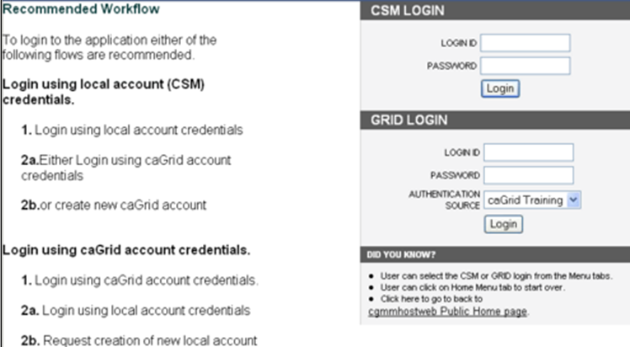
Missing statement of overall purpose and consequence of the tool. Of particular concern, user may be unaware that upcoming actions are irreversible.
Side-by-side presentation of instructions and entry fields may be confusing.
Recommend providing instructions to guide user to a specific path through tool, interspersing instruction and entry fields.
Screen mock-ups are included at end of briefing.
Initial login screen
User-Centered Design • www.user-centereddesign.com

Slide 5
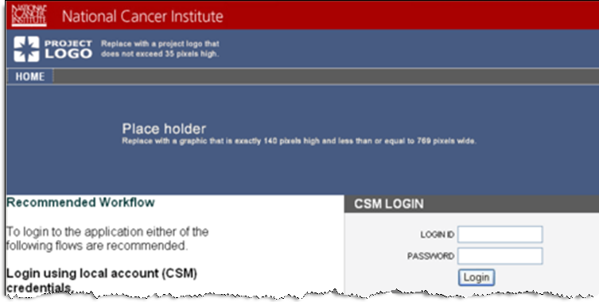
Initial login screen
Use of Home tab may be confusing to users since the host application is likely to have its own navigation, including a Home page. Recommend that this tool be popped out in its own window, with no internal navigation or Home.
User-Centered Design • www.user-centereddesign.com

Slide 6
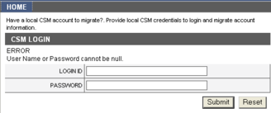
Login to a CSM account
Instructions on this page are easy to miss because the font is small and the text is overwhelmed by the strong, dark block containing ‘CSM LOGIN.’ Consider an alternative visual treatment for this input area. (See mockup at end of briefing.)
User-Centered Design • www.user-centereddesign.com

Slide 7
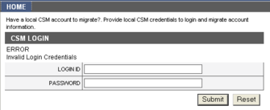
Login to a CSM account
Error messages should be clear and indicate what was wrong. This is an example of a helpful error message.
This error message could be clarified, e.g., Invalid login or password.
User-Centered Design • www.user-centereddesign.com

Slide 8
Login Errors
Consider placing login errors on the homepage where the initial login is executed instead of on a new page. It will help the user see the error more clearly and is consistent with popular login protocols.
Consider placing login errors on the page where the initial login is executed instead of on a new page. It will help the user see the error more clearly and is consistent with popular login protocols.
User-Centered Design • www.user-centereddesign.com

Slide 9
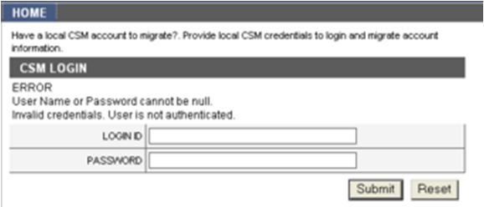
Login to a CSM account
Clicking Reset clears the input fields, but then submits the fields for Submission, resulting in an error message. Consider removing the Reset button since there are only two fields.
User-Centered Design • www.user-centereddesign.com

Slide 10
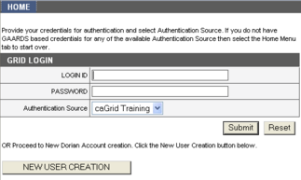
Login to a GRID account
Upon reaching this page, user has successfully logged into CSM account, but there is no indication of this. Same situation occurs when user logs onto GRID account first. Recommend noting successful login as well as the account id.
User-Centered Design • www.user-centereddesign.com

Slide 11
Login to a GRID account
Consider rewording the instructions for clarity, e.g., Enter your Login ID, Password and Authentication Source, or click Create New GRID Account button.
GRID account is referred to in multiple ways: GAARDS based credentials, Dorian Account, and GRID account. Maintain consistent terminology for clarity.
User-Centered Design • www.user-centereddesign.com

Slide 12
Login to a GRID account
Increase font size on instructions. Consider using a different visual treatment for GRID account login to distinguish it from the CSM account login.
User-Centered Design • www.user-centereddesign.com

Slide 13
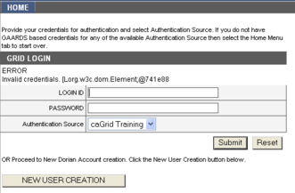
Login to a GRID account
Error message is easy to miss and is confusing. Consider rewording, e.g., Invalid Logon ID or Password.
User-Centered Design • www.user-centereddesign.com

Slide 14
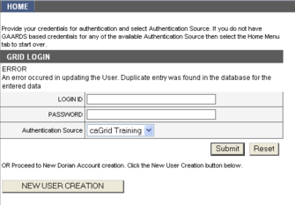
Login to GRID account
Upon reaching this page, user has logged into CSM account and then tried to login to GRID account that was already assigned to a different CSM account. Error message may be confusing.
User-Centered Design • www.user-centereddesign.com

Slide 15

Create new CSM account
User clicked “New User Creation” button to create a new CSM account.
Consider changing button label to “Create New CSM Account.”
Similar recommendation for creation of new GRID account.
User-Centered Design • www.user-centereddesign.com

Slide 16
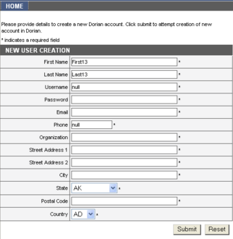
Creating a new GRID account
Use of ‘Dorian’ in instructions may be confusing to some since other references are to ‘GRID’ accounts.
Since all fields are required, indicate this at top of form. Also, placement of ‘*’ at end of each field is non-standard and easy to miss. Consider moving ‘*’ next to field name.
User-Centered Design • www.user-centereddesign.com

Slide 17
Creating a new GRID account
There is no indication of character requirements for each field, e.g., length of username or permissible characters in password. Include these explicitly on this page, or on roll-over on field names.
Should Street Address 2 be required? On most forms it is not.
User-Centered Design • www.user-centereddesign.com

Slide 18
Creating a new GRID account
When an error is detected, provide all the requirements for the field.
There is no value checking on some fields: Postal Code, Phone.
When there’s an error on a field, several fields are cleared that do not need to be: Street Address 1 and 2, Postal Code, City, State, Country.
User-Centered Design • www.user-centereddesign.com

Slide 19

Creating a new GRID account
Successful migration notice given as soon as GRID account was created or logged in.
  No indication that new GRID account was created.
  No indication of what accounts were processed (CSM or GRID).
  No confirmation prior to irreversible action.
User-Centered Design • www.user-centereddesign.com

Slide 20
Screenshots of Recommendations

Slide 21
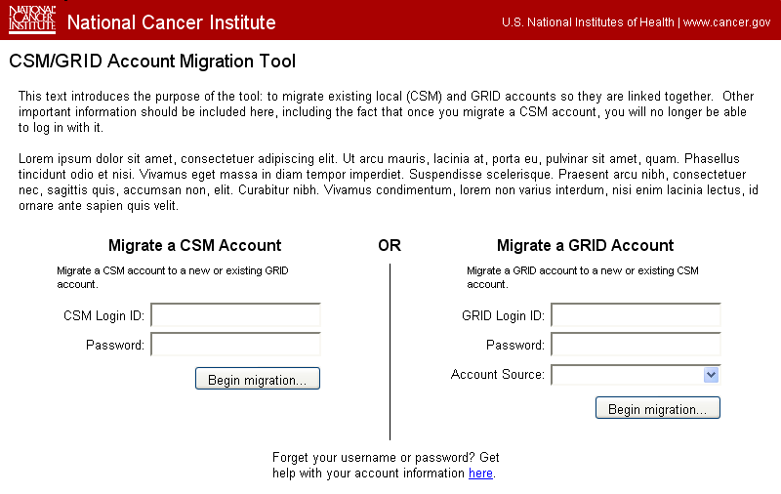
Initial Login/Migration Screen
User-Centered Design • www.user-centereddesign.com
Notes:
Instructions, add:
Purpose of this tool
Warning/explanation that successful use of this tool results in the CSM account no longer being active/usable.
If user doesn’t have either acct, can’t use this process.
Where user can go for further explanation/help

Slide 22
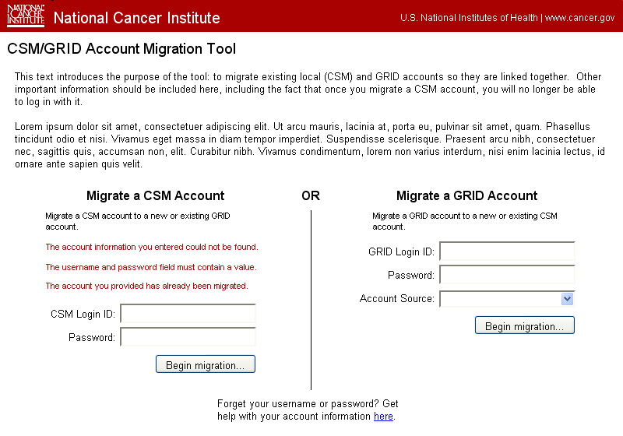
Initial Login Screen, Showing Potential Error Messages

Slide 23
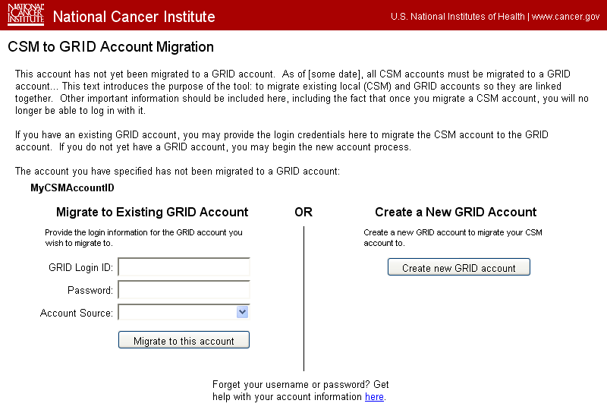
User has logged into a CSM account
Notes:
User has logged into a CSM accout.

Slide 24
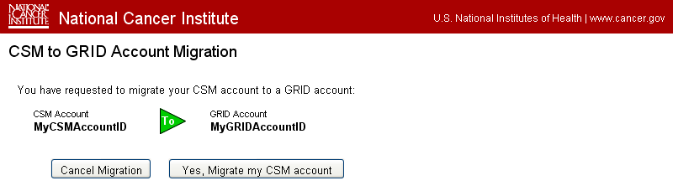
User has entered valid CSM and GRID account credentials

Slide 25
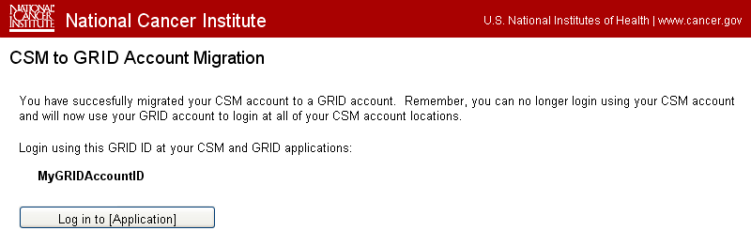
User has successfully migrated the CSM account to a GRID account

Slide 26
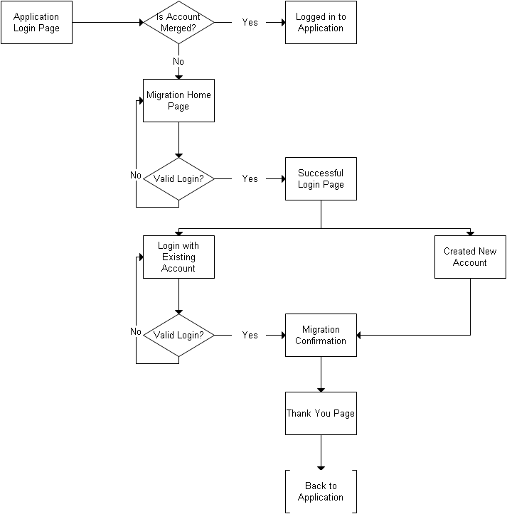
CGMM tool logic flow
User-Centered Design • www.user-centereddesign.com

